Slide 1
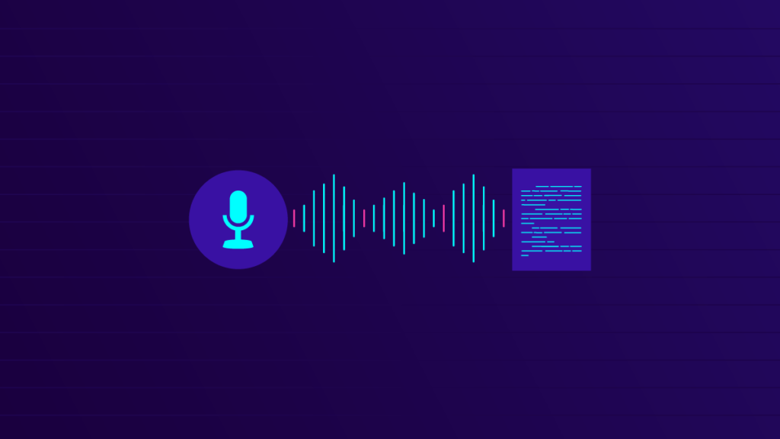

Automatic Speech Recognition

Slide 2
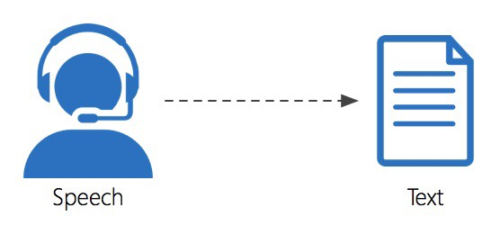
What is ASR?
An ASR system “understand” the given input of sound waves and covert into text format.
Ideal ASR System should be able to recognize the spoken utterances accurately

Slide 3
What we expect from Speech recognition systems?
Global Vocabulary
Noise Robustness
Automatic Punctuation
Accuracy

Slide 4
Why is ASR desirable for all Languages?
Speech is the primary means of human communication
Develop Interface for both literate and moderate users
It can also contribute to preserve the endangered languages
We have around 7000 languages and around 100 languages (only) have matured ASR system

Slide 5
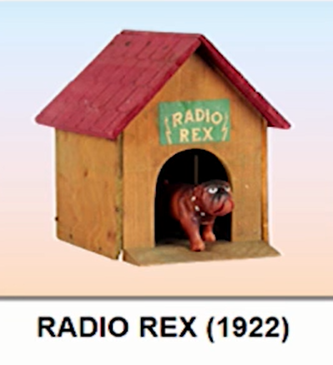
HISTORY OF ASR
Frequency of Female Voice = 165-255 HZ
Frequency of Male Voice = 85-185 HZ
1922
Automatic Speech Recognition: A Review, December 2012

Slide 6
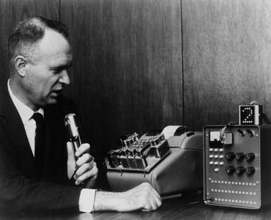
HISTORY OF ASR
ShoeBox (IBM) 1-16 isolated words
1 word
1922
1962
Automatic Speech Recognition: A Review, December 2012

Slide 7

HISTORY OF ASR
HARPY-1976 connected words
16 words
isolated
1 word
1922
1962
Automatic Speech Recognition: A Review, December 2012

Slide 8
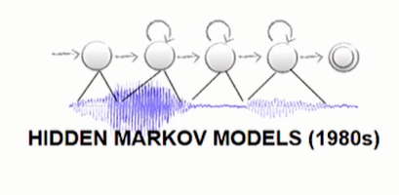
HISTORY OF ASR
10K+ words with LVCSR
1000 words
Connected
Speech
16 words
isolated
1 word
1922
1962
1976
Automatic Speech Recognition: A Review, December 2012

Slide 9
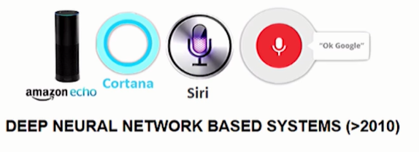
HISTORY OF ASR
1000 words
Connected
Speech
10K+ words
LVCSR System
16 words
isolated
1 word
1922
1962
1976
1982
2012
Automatic Speech Recognition: A Review, December 2012

Slide 10
HISTORY OF ASR
1000 words
Connected
Speech
10K+ words
LVCSR System
Fully connected (DNNs)
Convolutional Networks (CNNs)
Recurrent Neural Networks (RNNs)
LSTMs
GRUs
16 words
isolated
1 word
1922
1962
1976
1982
2012
2017 . . .
Automatic Speech Recognition: A Review, December 2012

Slide 11


Industry report
STATISTA
FOUND THAT APPROXIMATELY 64% OF SURVEYED EXPERTS WITHIN THE INDUSTRIES OF E-LEARNING AND MARKET RESEARCH USED SPEECHTO-TEXT AUTOMATED TRANSCRIPTION IN 2020
TECHCRUNCH
REPORTS THAT THE NUMBER OF DEVICES WITH VOICE ASSISTANTS INSTALLED IN 2020 WAS OVER TWO
BILLION
Facebook
claims that people now watch over 100 million hours of video on Facebook each day. the captioned video ads increase video view time by an average of 12%
Google
27% of the global online population is using voice search on mobile.

Slide 12
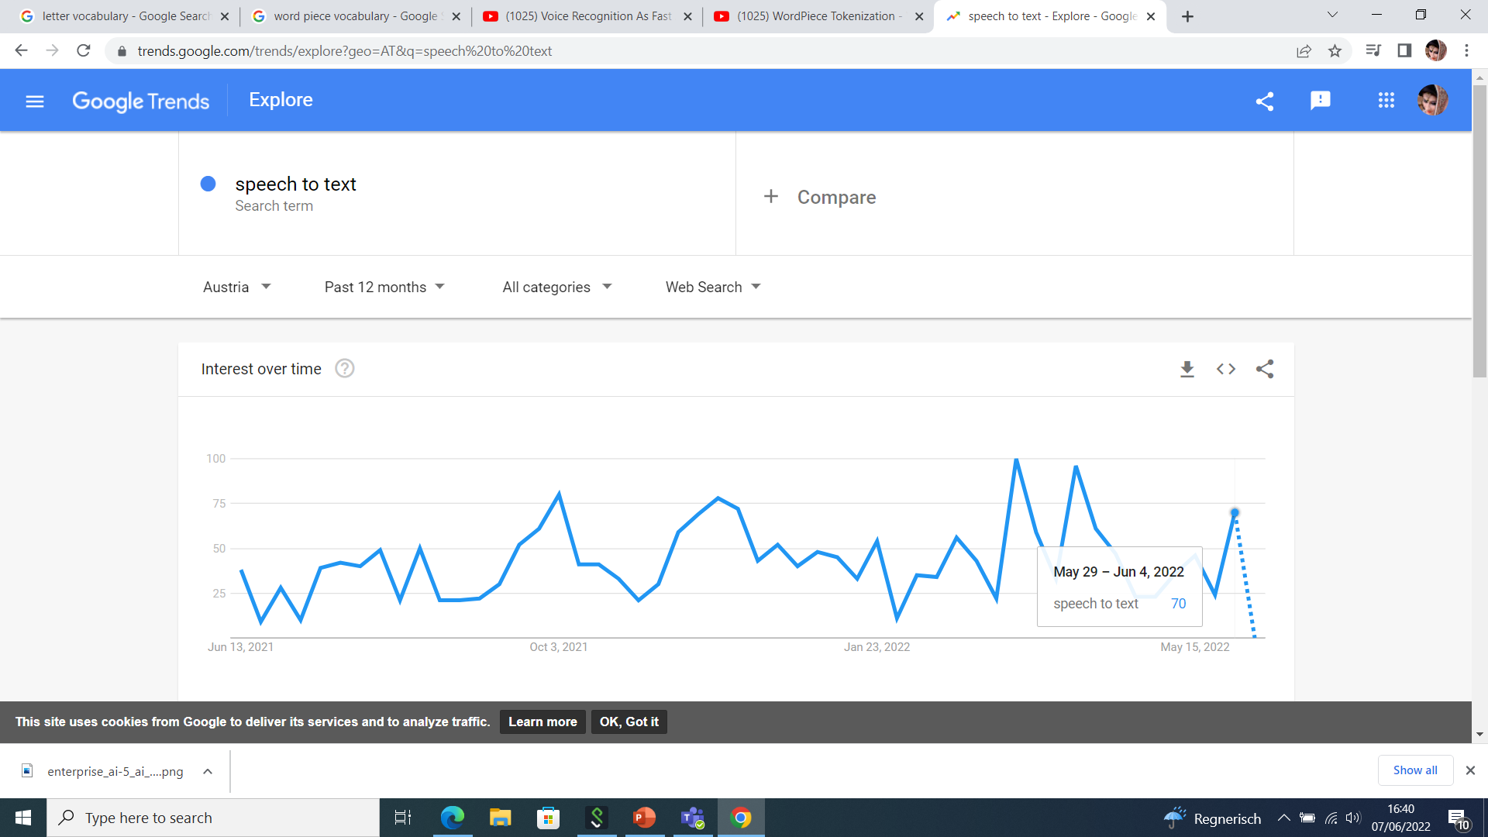
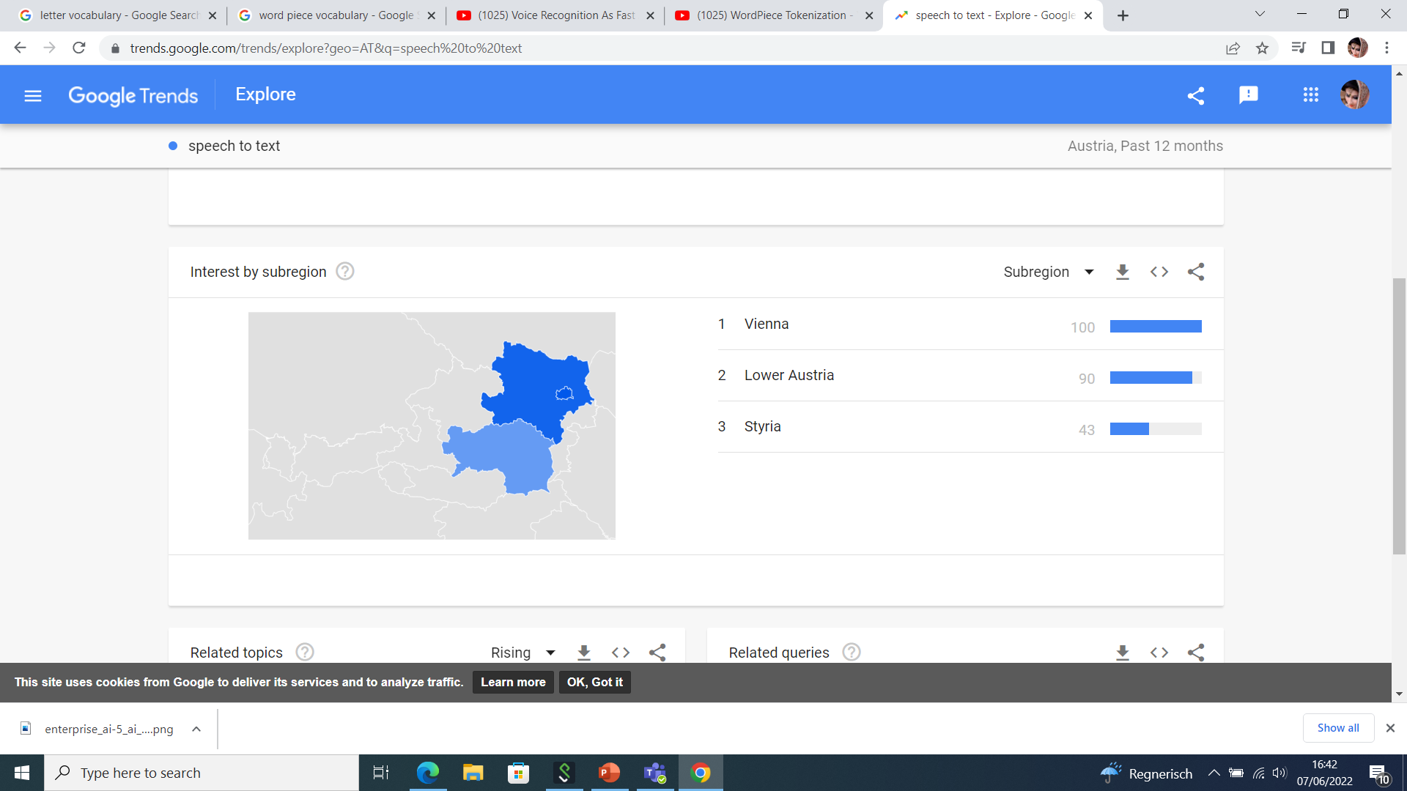
Notes:
According to the results on Google trends Speech to text domain is on more focus in last 12 months.

Slide 13
Speech Representation:
Sound is produced by changing air pressure produced through the excitation from vocal cords
The sound is modulated by moving/shaping of mouth (tongue, teeth, lips)
Sound Frequency
Human Hearing Frequency Range: 20HZ to 20KHZ (approx.)
Human Speech: 85 HZ to 8KHZ (approx.)
For ASR Speech processing is mostly done around 16 KHZ 16bits/sample

Slide 14
Challenges for Speech recognition Systems
Handling noisy real-life settings with multiple speakers (e.g. meetings, parties)
High Quality embedded ASR System to run locally on mobile phones
Reduce duplicate efforts across multiple dialects/languages
Should be robust to variation in age, accent
Should be able to handle coding switching and code mixing which is common in multilingual

Slide 15
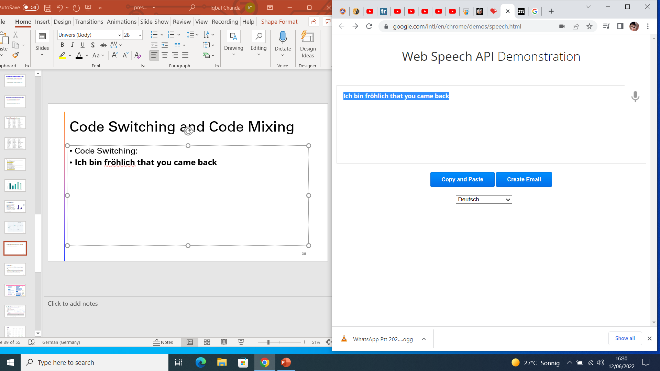
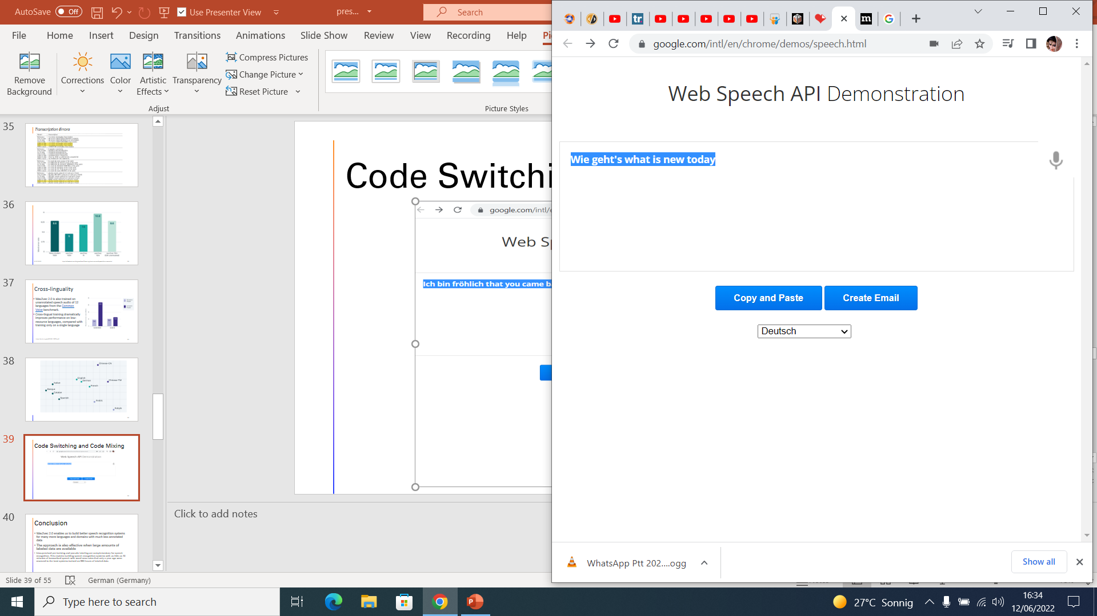
Code Switching and Code Mixing

Slide 16

Accents in Speech Recognition
Accents in Speech Recognition are serious challenges
REF:
A year before his retirement he was appointed Chaplain of the Swedish Royal Household.
Test:
Before his retirement he was appointed champion of the world
Recording Sample from commonvoice.mozilla.org/en
Testes on Google ASR System
www.google.com/intl/en/chrome/demos/speech.html

Slide 17
Speech is really a next computer interface

Slide 18
What we need to build a speech recognition system?
Speech recognition systems learn from human
Language Model
Lexicon Model
Acoustic Model
Speech
Text

Slide 19
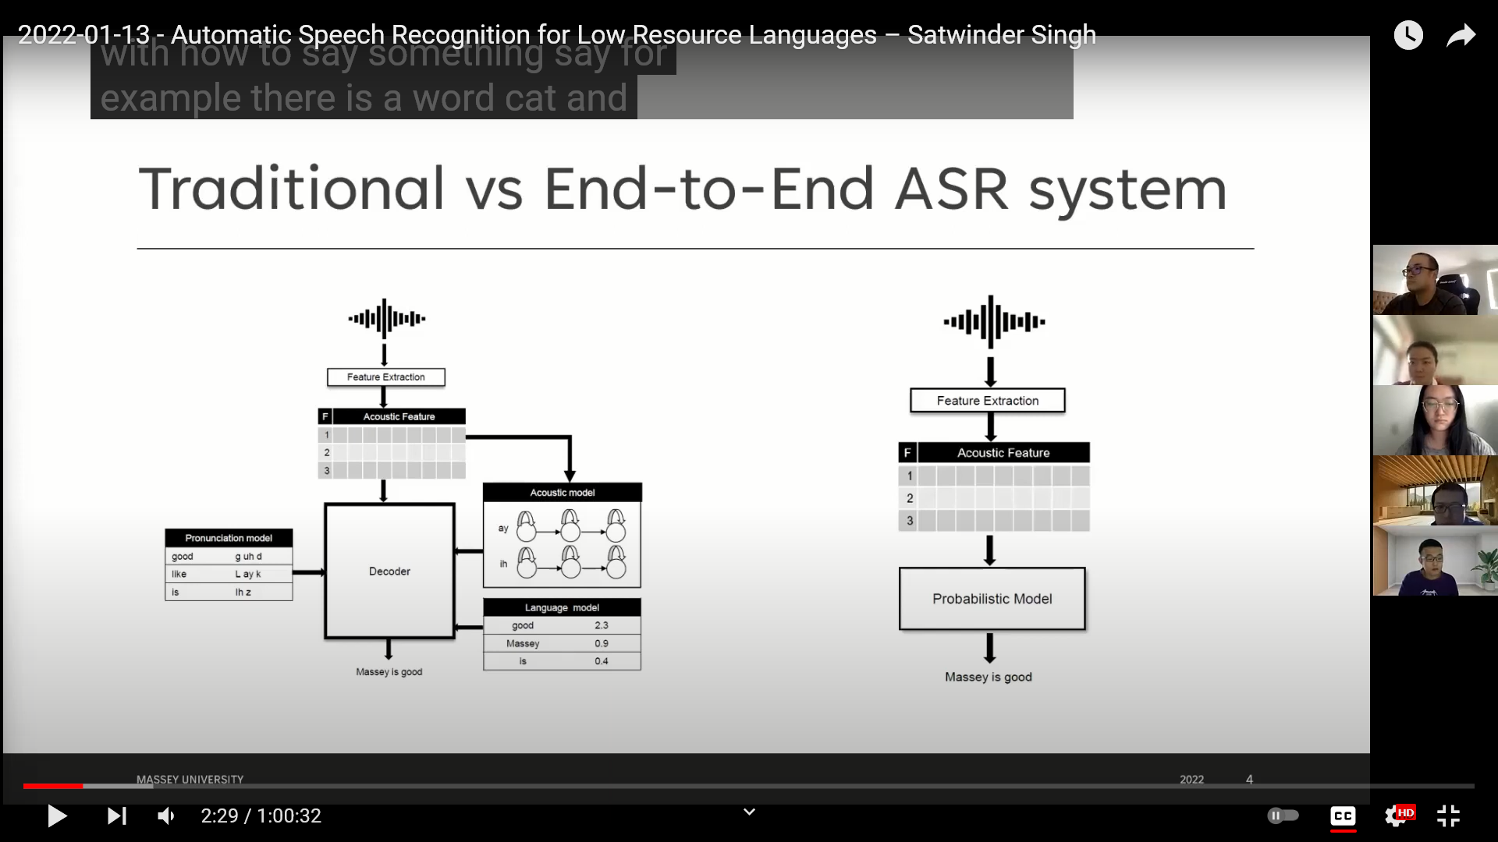
Traditional Vs End to End ASR systems
Audio Input
Audio Input
Sarah is good
Sarah is good

Slide 20
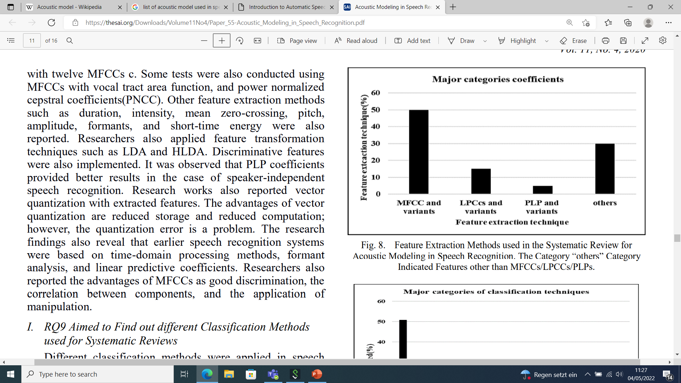
Feature Extraction techniques
Different feature extraction techniques that has been used are as following:
1. Mel-Frequency Cepstrum Coefficients (MFCC)
2. Linear Predictive Coding (LPC)
3. Linear Prediction Cepstral Coefficients (LPCC)
4. Perceptual Linear Prediction (PLP)
5. Linear Discriminant Analysis (LDA)
6. Discrete Wavelet Transform (DWT)
7. Relative Spectral (RASTA-PLP)
8. Principal Component analysis (PCA)
Shohba et al.,2020

Slide 21
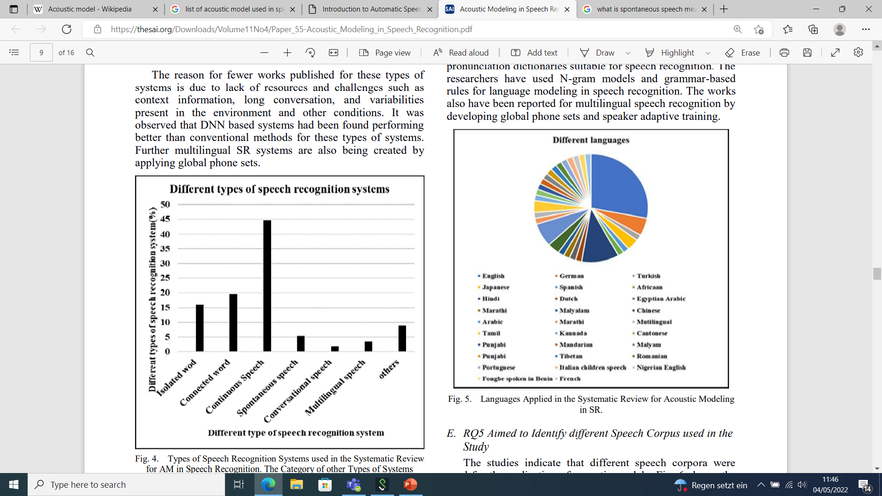
Types of ASR Systems
The research findings indicate:
Significant research work has presented for continuous speech and connected words due to their more applications.
A limited work has been reported towards spontaneous speech, conversational speech, and multilingual speech.
Shohba et al.,2020

Slide 22
Evaluation techniques for ASR
The performance of a speech recognition system usually depends on two factors:
The Accuracy of the output produced
The processing Speed of the ASR
Word Error Rate (WER) and Word Recognition Rate (WRR) is used to find the accuracy of system
The Real-time factor (RTF) is the most commonly used metric for calculating the speed of a proposed model

Slide 23
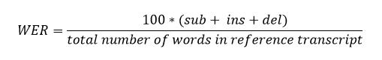
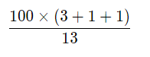
Evaluation automatic speech recognition systems
The standard measurement to assess the performance of an automatic speech recognition (ASR) system is WER (Jelinek, 1997)
Three types of errors can be distinguished:
substitutions (sub) transcribed wrongly
deletions (del) omitted during transcription
insertions (ins) omitted during recording
REF | Speech | is | human | silence | is | divine | *** | we | must | learn | both | of | these | arts
ASR | Speech | is | human | silence | is | there | but | we | must | learn | **** | for | his | arts
Error |  |  |  |  |  | SUB | INS |  |  |  | DEL | SUB | SUB
=
=
38.46%.
Notes:
https://www.italk2learn.com/evaluating-performance-of-automatic-speech-recognition-systems/

Slide 24
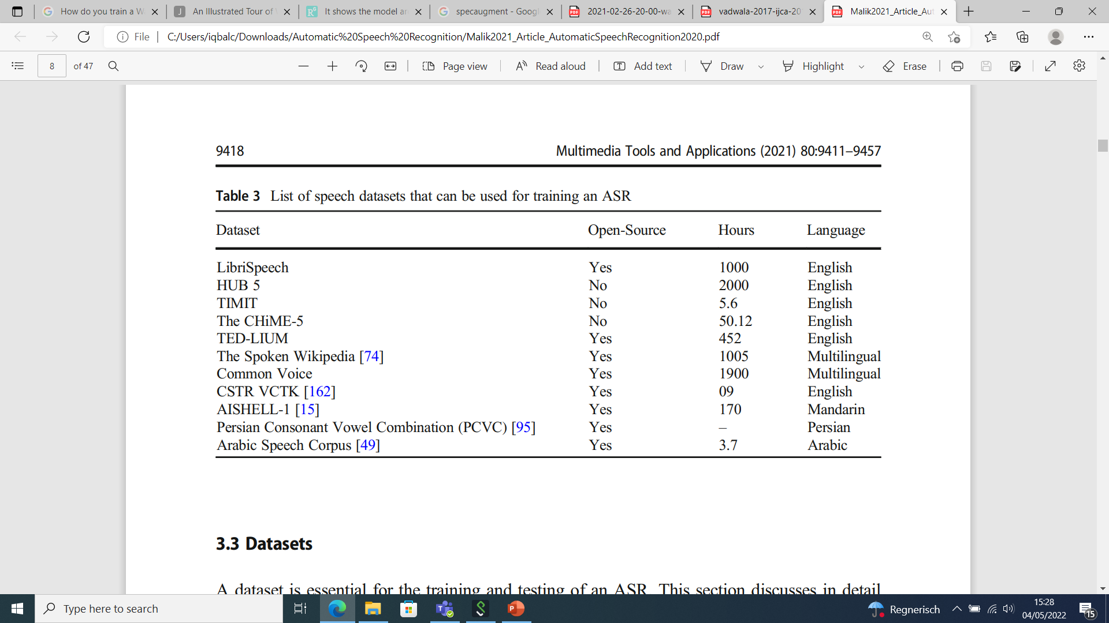
List of datasets that can be used for training ASR
Malik et at., 2021

Slide 25
Can computer good at recognizing speech as human?

Slide 26
How does human learn?
Thanks to Semi-Supervised Learning

Slide 27
Why this model (Wav2vec2.0)?
The idea behind the Wav2vec series is semi supervised learning
SOTA models require thousands of hours of transcribed speech
So many data are not available for the vast majority of the nearly 7,000 languages
For noncommercial companies its almost impossible to obtain such an amount of data

Slide 28
Wav2vec2.0
Wav2Vec2 is a pretrained model for Automatic Speech Recognition (ASR) and was released in September 2020
For the first time, it has been shown that pretraining, followed by fine-tuning on very little labeled speech data achieves competitive results to state-of-the-art ASR systems.
With just one hour of labeled training data, it outperforms the previous state of the art— using 100 times less labeled data.

Slide 29
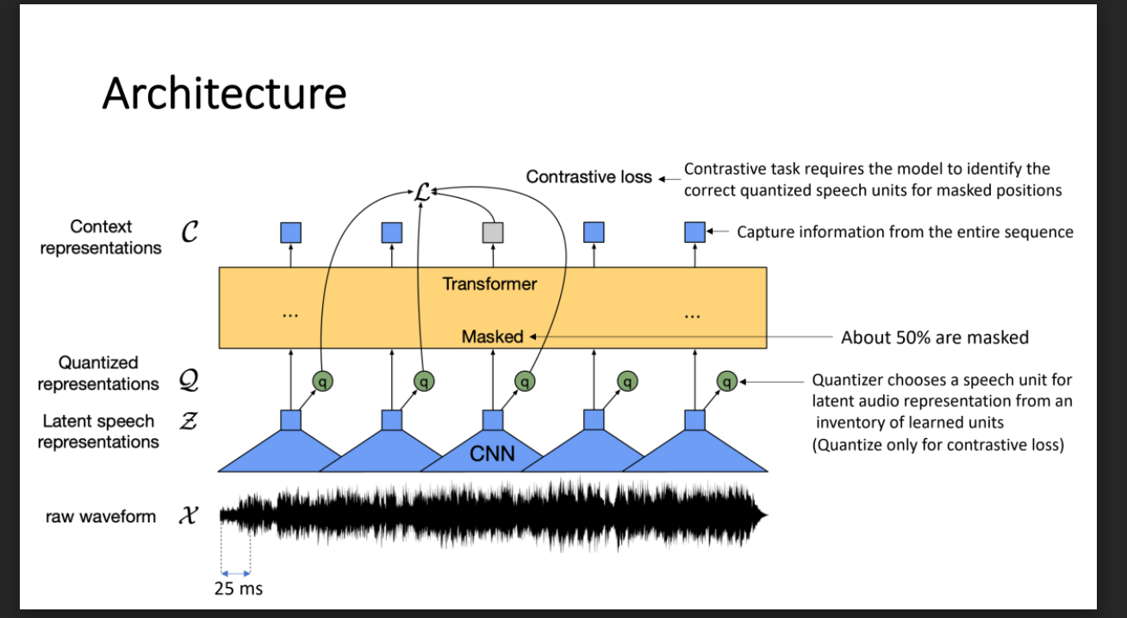

Slide 30
Wav2vec2 Models
 | wav2vec2-base-960h | wav2vec2-large-960h | wav2vec2-large-960h-lv60 | wav2vec2-large-960h-lv60-ST
 | BASE contains 12 transformer blocks 250k audio samples, or 15.6sec | LARGE contains 24 transformer blocks 320K audio samples, or 20 sec | pretrained and fine-tuned on 960 hours of Libri-Light and Librispeech on 16kHz | 1 Model was trained with Self-Training objective
WER- Clean | 2.1 | 2.0 | 1.8 | 1.5
WER- Other | 4.8 | 4.1 | 3.3 | 3.1
1. Qiantong Xu et al., 2021

Slide 31
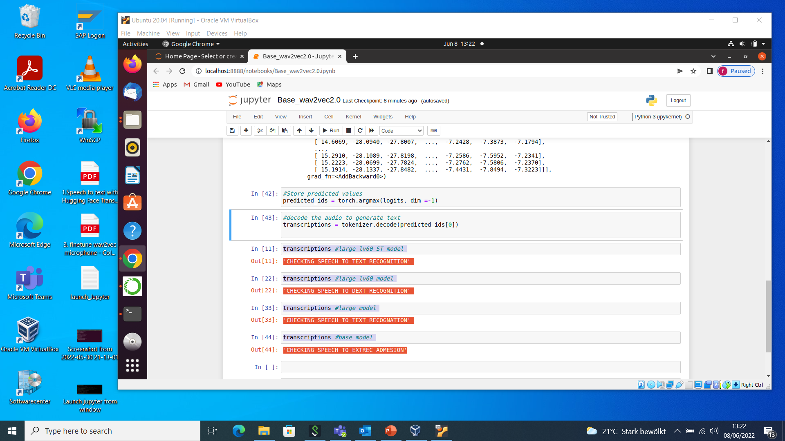

Slide 32
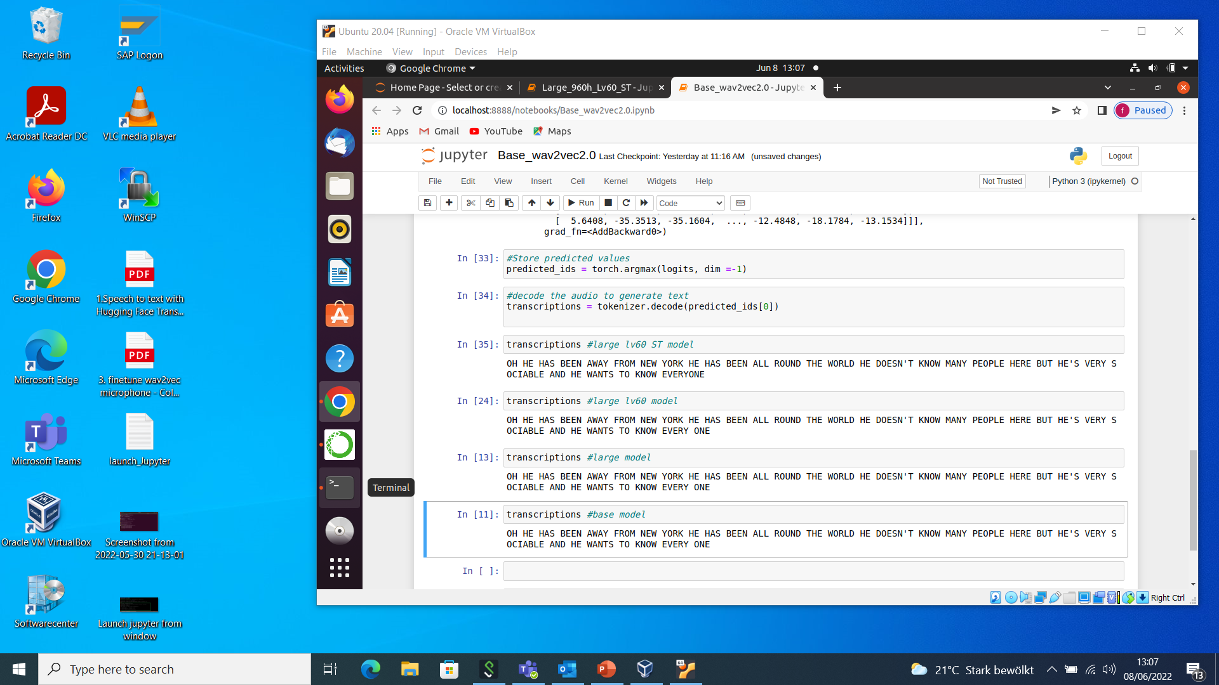

Slide 33

it wasn't like i was asking for the code to a nuclear bunker or anything like that but the amount of resistance i got from this. Sample-Audio-1
It was not like I was asking for the code to a newclear bunker or anything like that but the a maunt of resistance i got from miss (0.551 s)
It was not like I was asking for the cod to a new clear bunker or anything like that but the amount of resistance i got from this (1.044 s)
It wasn't like I was asking for the code to a nclear bunker or anything like that but the amount of resistance i got from this (1.167 s)
It wasn't like I was asking for the code to a nuclear bunker or anything like that but the amount of resistance i got from this (1.106 s)

Slide 34
“Oh, he has been away from New York—he has been all round the world. He doesn't know many people here, but he's very sociable, and he wants to know every one.” Sample-Audio-2
Oh he has been away from new york he has been all round the world he doesn't know many people here but he's very sociable and he wants to know every one (0.667 s)
Oh he has been away from new york he has been all round the world he doesn't know many people here but he's very sociable and he wants to know every one (1.560 s)
Oh he has been away from new york he has been all round the world he doesn't know many people here but he's very sociable and he wants to know every one (2.214 s)
Oh he has been away from new york he has been all round the world he doesn't know many people here but he's very sociable and he wants to know everyone (1.406 s)

Slide 35
chances are that they are rooted in the productivity crisis Sample-Audio-3
Chances are that they are rutedi the prodetivity crizes (0.348 s)
Chances are that they are rooted in the productivity crises (0.747 s)
Chances are that they are rooted in the productivity crisis (0.767 s)
Chances are that they are rooted in the productivity crisis (0.706 s)

Slide 36
"SWEAT COVERED BRION'S BODY TRICKLING INTO THE TIGHT LOWING CLOTH THAT WAS THE ONLY GARMENT HE WORE"
"SWEAT COVERED BRION'S BODY TRICKLING INTO THE TIGHT LOIN CLOTH THAT WAS THE ONLY GARMENT HE WORE"
"SWEAT COVERED BRION'S BODY TRICKLING INTO THE TIGHT LOIN CLOTH THAT WAS THE ONLY GARMENT HE WORE"
"SWEAT COVERED BRION'S BODY TRICKLING INTO THE TIGHT LOIN CLOTH THAT WAS THE ONLY GARMENT HE WORE"

Slide 37
I am checking the performance of speech to text recognition
I am checking the performance of speech to extrecognition (0.458 s)
I am taking the performance of speech to text recognition (1.144 s)
I am checking the performance of speech to dext recognition (1.542 s)
I am checking the performance of speech to text recognition (1.157s)

Slide 38
Learn powerful representations from speech audio
LEN OUR FORTHE REPRESENTATIONS FROM SPEECH AUDUE (0.594 s)
LEARN POWERFUL REPRESENTATIONS FROM SPEECH ARDU (0.979 s)
LEARN POWERFUL REPRESENTATIONS FROM SPEECH ODIO (1.943 s)
LEARN POWERFUL REPRESENTATIONS FROM SPEECH AUDIO(1.143s)

Slide 39
Our speech is our identity
Notes:
Our voice is also unique like our looks, fingerprints and it also identifies us.
https://paperswithcode.com/sota/automatic-speech-recognition-on-librispeech-2
https://paperswithcode.com/sota/speech-recognition-on-librispeech-test-clean

Slide 40
THANK YOU

